Slide 1
Privacy Preserving Machine Learning on Cloud Platforms
Robert Podschwadt
rpodschwadt1@student.gsu

Slide 2



Machine Learning as a Service (MLaaS)
Cloud/Server/Service Provider
1. Send data
User
3. Receive result
2. Perform computation

Slide 3
The problem with MLaaS
Cloud/Server/Service Provider
1. Send data
User
3. Receive result
2. Perform computation and hoard data
The cloud gets to keep all the data!

Slide 4
The Scenario
Client
Owns the data
Wants to use an ML service provided by the server
The data is privacy sensitive
Server
Provides MLaaS
Hosts a DNN model
Both parties are honest but curios
They follow the protocol…
… but will try to learn anything they can

Slide 5

Solving Privacy Issues
Cloud/Server/Service Provider
1. Send encrypted data
User
3. Receive encrypted result
2. Perform computation over encrypted data

Slide 6
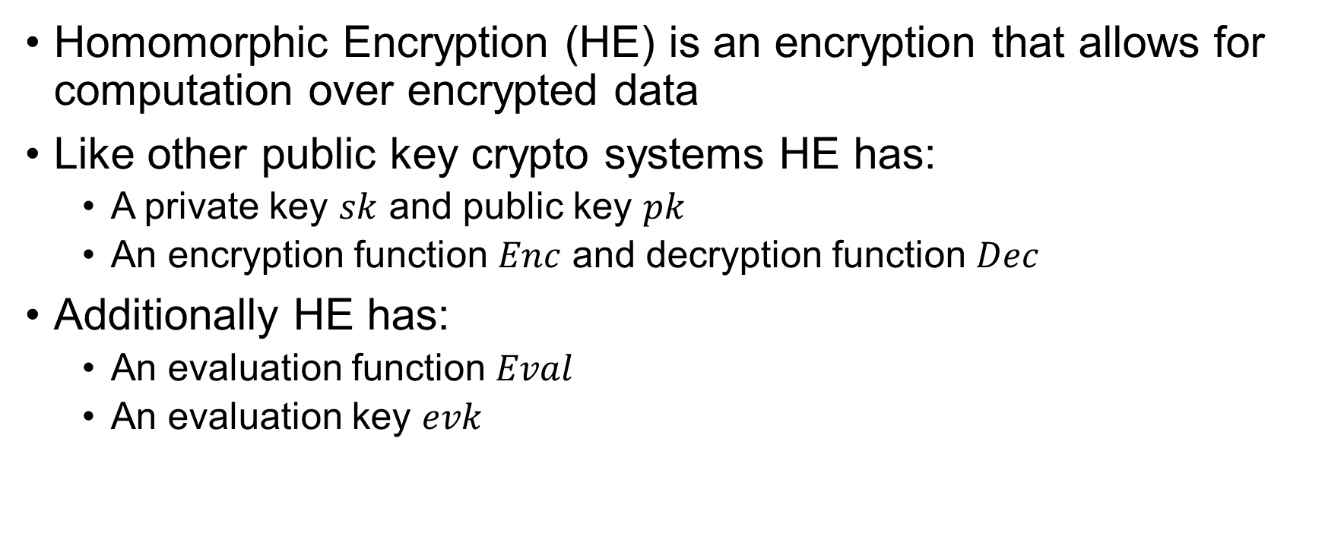
Background: Homomorphic Encryption 1/2
Homomorphic Encryption (HE) is an encryption that allows for computation over encrypted data
Like other public key crypto systems HE has:
A private key $sk$ and public key $pk$
An encryption function $Enc$ and decryption function $Dec$
Additionally HE has:
An evaluation function $Eval$
An evaluation key $evk$

Slide 7
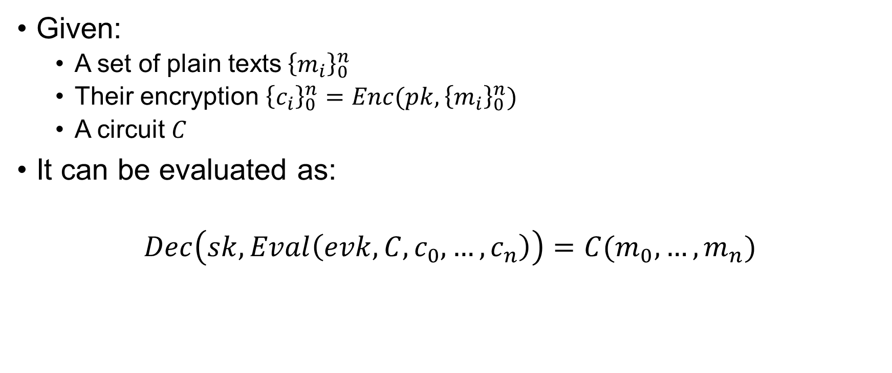
Background: Homomorphic Encryption 2/2
Given:
A set of plain texts${\left\{m_{i}\right\}}_{0}^{n}$
Their encryption ${\left\{c_{i}\right\}}_{0}^{n}=Enc(pk,{\left\{m_{i}\right\}}_{0}^{n})$
A circuit $C$
It can be evaluated as:
$$Dec\left(sk,Eval\left(evk,C,c_{0},…,c_{n}\right)\right)=C(m_{0},…,m_{n})$$

Slide 8
Background: CKKS and Limitations
We use CKKS [Cheon et al., ASIACRYPT 2017]
Allows for real-valued plain texts
Supported operations:
Addition and Subtraction of both cipher texts and plain texts
Multiplication of both cipher texts and plain texts
Division with plain text divisors only
Packing multiple plain texts into a single cipher text
Allows for Single Instruction Multiple Data (SIMD) processing
Every operation adds noise to the cipher text
If the noise passes a threshold correct decryption becomes impossible

Slide 9
Machine Learning using HE
Limitations
No: Comparison, Division, Powers, Log, etc
Only polynomials
Model depth is limited
How can we solve this?
Most operations in NNs are not a problem
Activation are replaced with polynomials approximations

Slide 10
A Story in two Parts
“Traditional” Machine Learning
Design learning algorithm
Design model
Train model
Feature extraction
Encrypted Execution
Private inference on encrypted data
Implementation of the algorithms based on crypto primitives
Imposes Constraints
Delivers weights

Slide 11
“Traditional” Machine Learning
Training is performed on plaintext
We can use standard ML libraries like TensorFlow, Torch, scikit learn, etc
There are constraints we need to consider
Most standard activation functions are not compatible
Not all types of layers can be used
Models can not be arbitrarily deep
If the ML library supports hardware acceleration, we can use. No modifications needed

Slide 12
Encrypted Execution
Training is done. The model is fixed
The Input and Output is encrypted
No high-level library available
It all runs on custom C++ code
No hardware acceleration
Yet
Extremely resource hungry

Slide 13
What resources are needed?
“Traditional” Machine Learning
+ Hardware accelerator
CPU
RAM
Encrypted Execution
+ CPU (the more cores the better)
+ RAM
+ Fast network
Hardware accelerator
Less important resources
- Storage

Slide 14









Previous “Systems”
My PC
CS Server
Uni HPC

Slide 15


The System
Training System
Storage
Inference System
Model
RAM
GPU
CPUs
Training Data
Test Data
Train Model
Result
Save Model

Slide 16
A more Powerful System – large Data
Inference System
RAM
Result
CPUs
Storage
Model
Test Data
RAM
Result
Model
CPUs
Test Data
…
Model
RAM
Test Data
Result
CPUs

Slide 17
A more Powerful System – lower latency
Inference System
Map to node
Share state
Storage
Result
Combine
Test Data
Model

Slide 18
Advantages
Only pay for the Hardware acceleration when we need it
Same goes for CPU time
Scale up to the problem
Since we pay time rather than machines parallel execution costs the same
Always newest hardware

Slide 19
Disadvantages
Money spent is money gone
Prototyping is more difficult
ML systems like auto ML not usable
Need more control over the ML system

Slide 20
Challenges
Keeping your options open
Interoperability
Design a system that can handle other similar problem
Functional Encryption, Secure Multiparty Computation
Prototyping and development
Dependencies of native libraries

Slide 21
Thank you

Slide 22
HE Backup Slides

Slide 23
Homomorphic Encryption - Types
Partially homomorphic encryption
Only support one type of operation like addition or multiplication
Somewhat homomorphic encryption
Support addition and multiplication but not all types of circuits
Leveled fully homomorphic encryption
Support addition and multiplication and circuits with a redefend depth
Fully homomorphic encryption
Support addition and multiplication and circuits of arbitrary depth

Slide 24
Fully Homomorphic Encryption - History
First proposed in 1978 after the publication of RSA
30 years of partial results
First-Generation FHE
Done by Craig Gentry in 2010
Based on ideal lattices
Encryption adds noise to the data
Operations increase the noise
If the noise is too large decryption is impossible
Introduction of the bootstrapping trick
Use scheme that can evaluate its own decryption function homomorphically
This refreshes the noise and allows for further computation

Slide 25
Fully Homomorphic Encryption - History
Second-Generation FHE
Mostly based on Ring Learning with Errors Problem (RLWE)
BGV https://eprint.iacr.org/2011/277
BFV https://eprint.iacr.org/2012/144
CKKS https://link.springer.com/chapter/10.1007%2F978-3-319-70694-8_15
Support for bootstrapping or leveled FHE
Third-Generation FHE
Faster bootstrapping
TFHE https://tfhe.github.io/tfhe/
Supports binary gates
High level operations need to pieced together

Slide 26
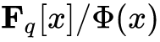
RLWE – The abridged version
Given:
Ring R:
set of random known polynomials a from R
Set of small random unknow polynomials e from R
a small unknow polynomial s from R
b = (a ⋅ s) + e
The problem
Find s given a and b
This is equivalent to the Approximate Shortest Vector Problem in ideal lattices

Slide 27
Homomorphic Encryption
HE allows for operation on the encrypted data without the need for decryption or access to the secret key
Perfect for PPML…..
… but there is a catch (multiple catches actually)
Only supports addition and multiplication
Noise growth
Execution time
Size
Pro: No interactions that are not in the plaintext version
Con: High computational cost
Basically trade off network traffic for CPU load

Slide 28
Homomorphic Encryption
Only supports addition and multiplication
Luckily most operations in DNNs are + or *
Other operations can be approximated by polynomials
Noise growth
Bootstrapping
Removes noise
Is slow
Leveled Encryption
Upper limit on the number of operations
Execution time
Single Instruction Multiple Data SIMD
Size
We have to live with it

Slide 29
Homomorphic Encryption
HE scheme of choice: CKKS (https://eprint.iacr.org/2016/421.pdf )
Allows for computation over real numbers
Based on Ring Learning With Errors
Plaintexts need to be encoded as polynomials over a ring
The secret key is a random polynomial over the same ring
Public key is created by adding random polynomials to the secret key
Encrypt a message by adding noise (random polynomials) the message

